Slide 1
Holiday Trip

Slide 2
Sample Program Output
Welcome to trip distance calculation app
Trip details
Istanbul -> Izmir [33,52 km]
Izmir -> Athens [36,13 km]
Athens -> Rome [125,32 km]
Rome -> Barcelona [108,90 km]
Barcelona -> Dubrovnik [168,27 km]
Dubrovnik -> Paris [178,28 km]
Paris -> Oslo [146,30 km]
Oslo -> Stockholm [77,33 km]
Stockholm -> Lisbon [359,59 km]
Total trip distance: 1233,640 km

Slide 3
How to store all Cities?
Store all cities read from file in an array list: ArrayList<City> city = new ArrayList<>();
You can use File in Scanner.
For example File f=new File(fileName) where fileName is a string.
You can split files by using split command
for example: sc.split( character) where character is a value and when that value occurs, it will split that line
Note that, each value from split command will be stored in an array.

Slide 4
UML Diagrams
City
+name : String
+xCoord : int
+yCoord: int
Name of City
xCoordinate
yCoordinateValue of an item
+City(name: String, xCoord: double, yCoord: double)
+calculateDistance(cityOneX: double, cityOneY: double, cityTwoX: double, cityTwoY: double): double
Constructor
Returns distance between two City

Slide 5
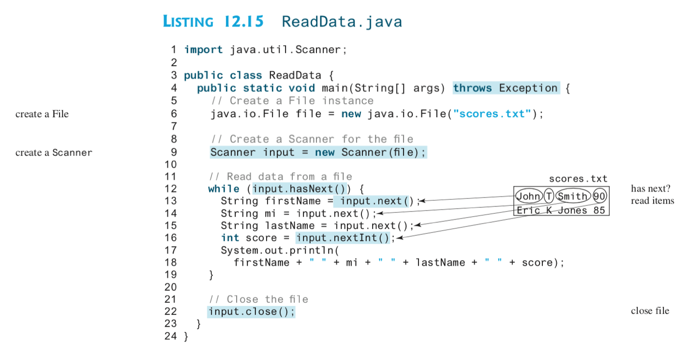
Read Data from a Text File: Example

